Slide 2
Cell-culture mediated isolation of African Swine Fever field viruses for vaccine production in Uganda
Presenter: Samuel Mulondo
Country and institution: Uganda, NARO-NaLIRRI

Slide 3
Agenda
What is the country situation with respect to ASF? (Endemic)
What are some of the key challenges faced?
(Diagnosis-Hard to pick all outbreaks; Limited resources; Technical limitation-Most do conventional PCR; No RDT for screening)
What is your vision for the swine sector in your country for the next 5 years/10 years?
(Track as many outbreaks as possible-capture the genomic changes; Attempting to develop a vaccine that matches genotype IX and X ASFVs)
4. What are your 3 – 5 expectations from this ASF GAP Analysis?

Slide 4
ASF Research team
Samuel Mulondo
Ezinga Richard
Kabaka Richard M
Daisy Iwutung
Moses T Dhikusooka
Swidiq Mugerwa
Kabuuka Tonny (Lead researcher #)

Slide 5
Aim - Attempting to develop a vaccine that protects against genotype IX and X ASFV
For development of an attenuated (live-attenuated) or inactivated ASFV vaccine candidate;
We need a cell line to grow and study both field and mutant or inactivated viruses

Slide 6
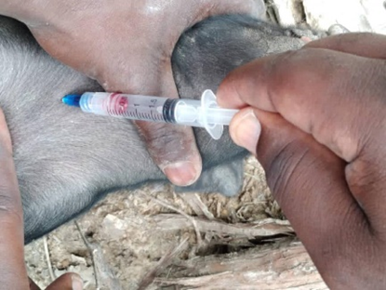
Methodology
Collected several ASF outbreak samples
Identified positive viruses using PCR
Developed a cell-line from domestic pigs (TDF submitted for IPR)
Infected domestic pig cell line with 5 viruses for 5-7 days

Slide 7
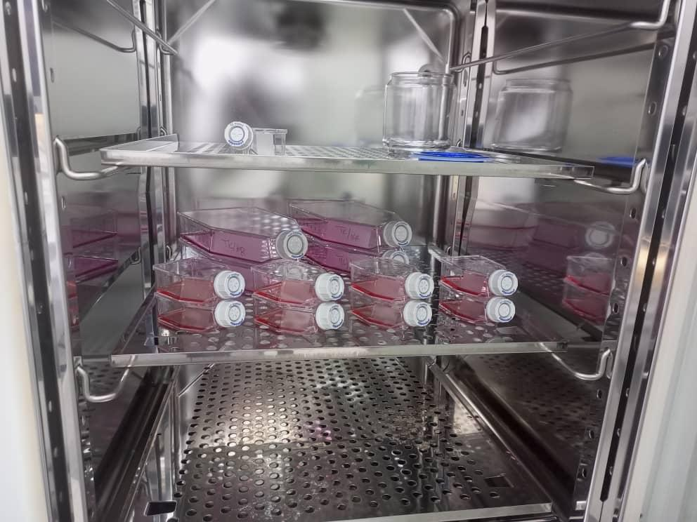
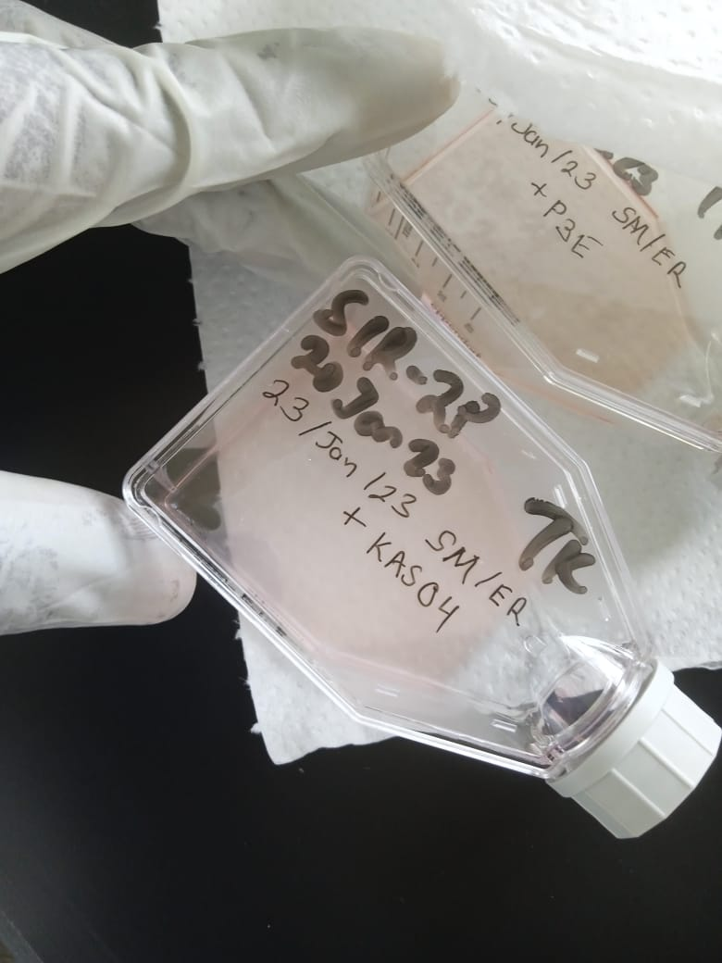
Methodology
Incubation of ASF viruses

Slide 8
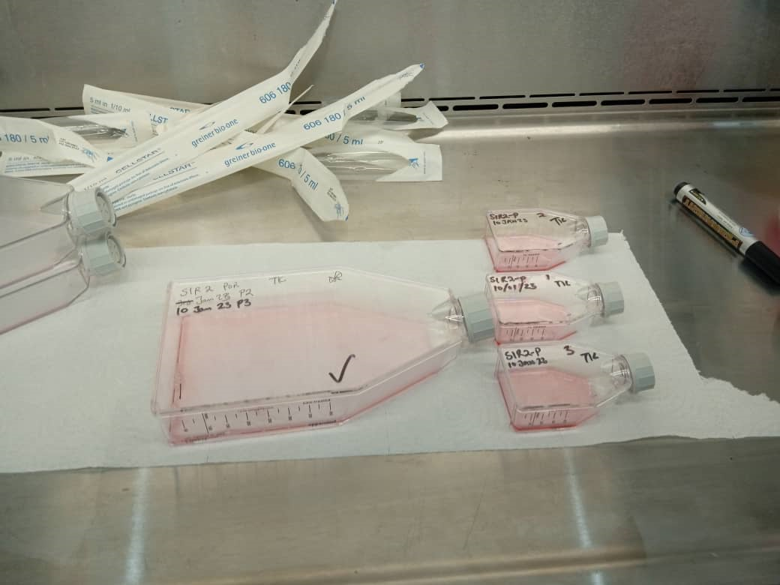
Infection and isolation of ASFV in Uganda
Seeding of T25 flasks with selected cell line before infection with ASFv

Slide 9
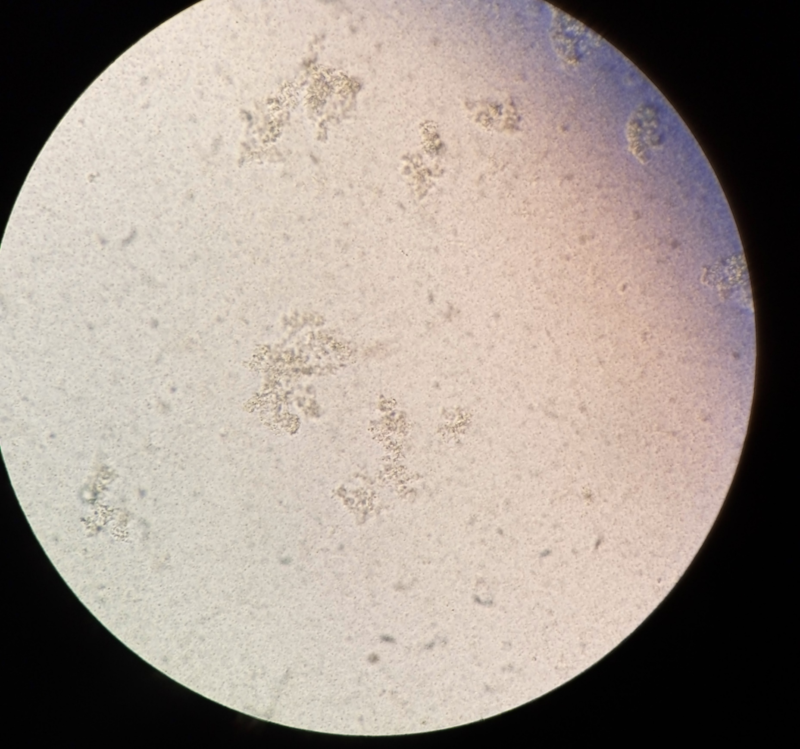
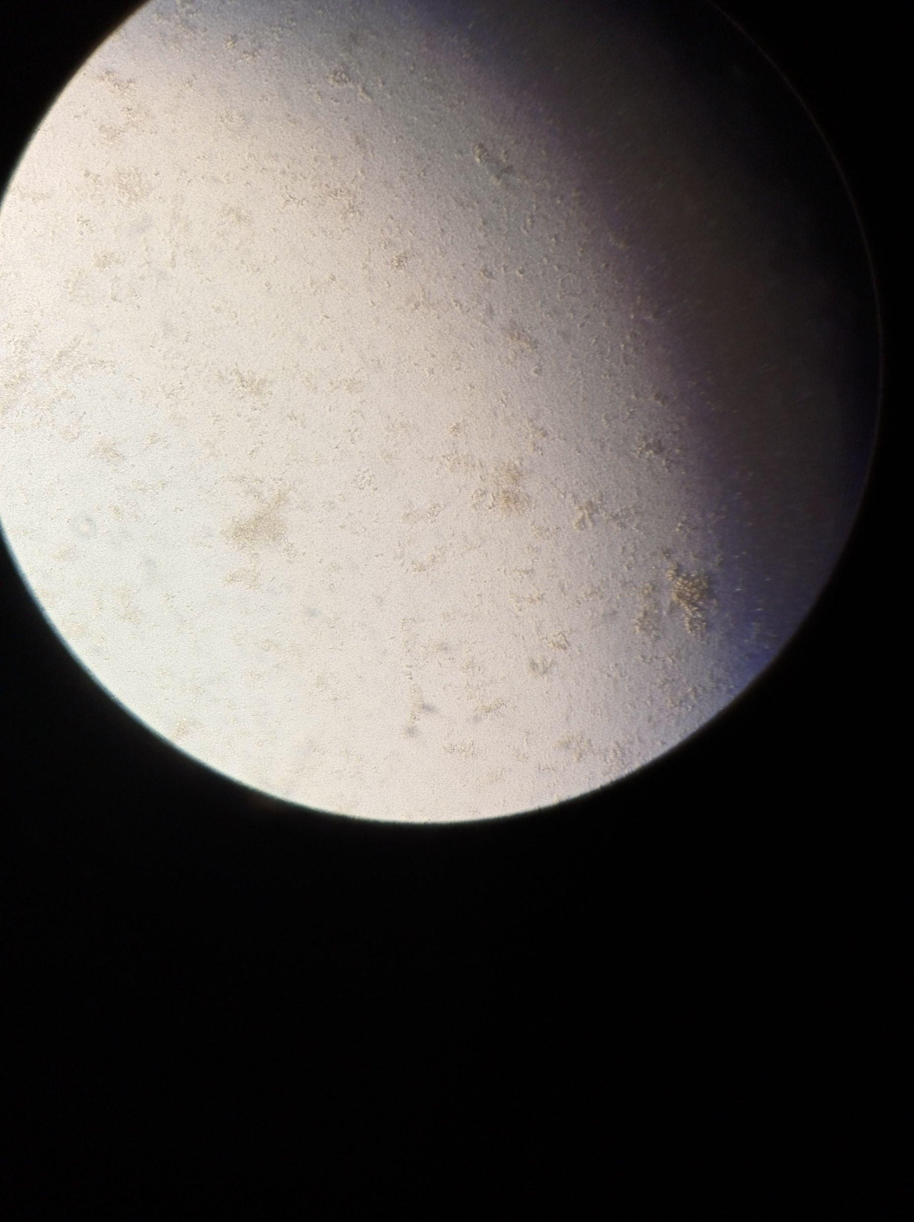
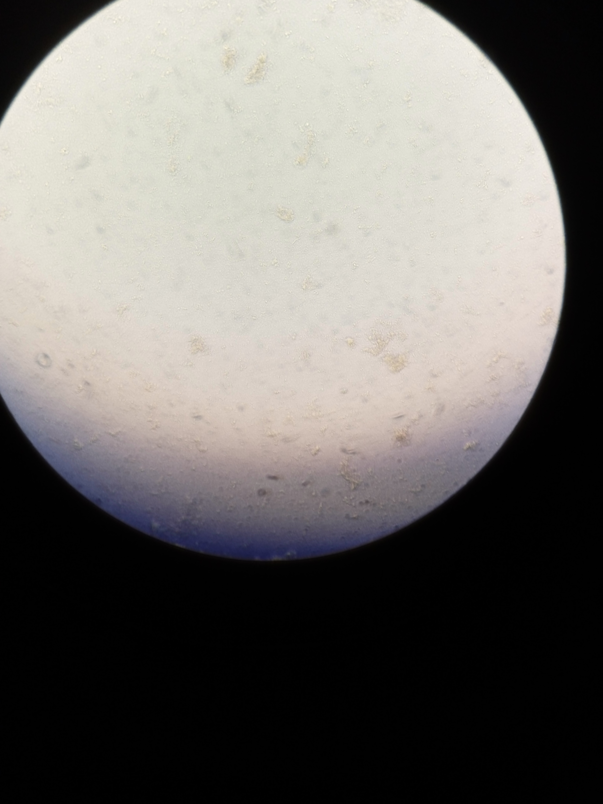
Results - Isolation of ASF viruses
Namayingo virus
Bunyangabu virus
Mukono virus
Plaques seen as shown under the red circles

Slide 10
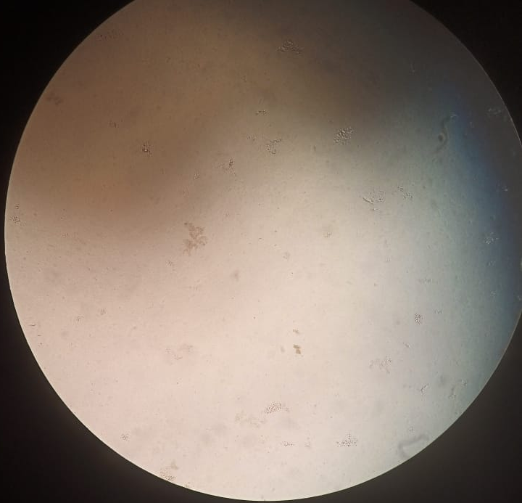
Isolation of ASF viruses
Kasese virus
Plaques seen as shown under the red circles

Slide 11
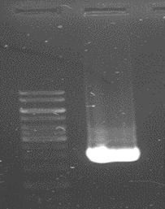
ASF Vaccine development work at NaLIRRI
pUC19 vector plasmid confirmation
Or Inactivated viruses option?
VS

Slide 12
Discussion
From 21 PCR-positive viruses, we selected 5 for isolation on the new selected cells
4 viruses from different regions in Uganda have been isolated as shown
1 more virus still being cultured

Slide 13
Conclusion
Our team has isolated 5 African Swine Fever Viruses using cell-culture in Uganda
Current efforts involve:
Purifying 5 viruses
In-vitro plaque titrations to determine titres, growth kinetics
Whole genome sequencing of 5 viruses
Inactivation as vaccine models
pUC19-deletion as live-attenuated vaccine models
Animal trials

Slide 14
Conclusion
Manuscript under preparation
Cell-culture mediated isolation of African Swine Fever field viruses for vaccine production in Uganda
Samuel Mulondo ¹, Ezinga, Richard ¹; Daisy, Iwutung ¹, Kabaka, Richard, M ¹; Moses Tefula Dhikusooka ¹; Swidiq Mugerwa ¹ ; Kabuuka, Tonny ^{1,} #

Slide 15
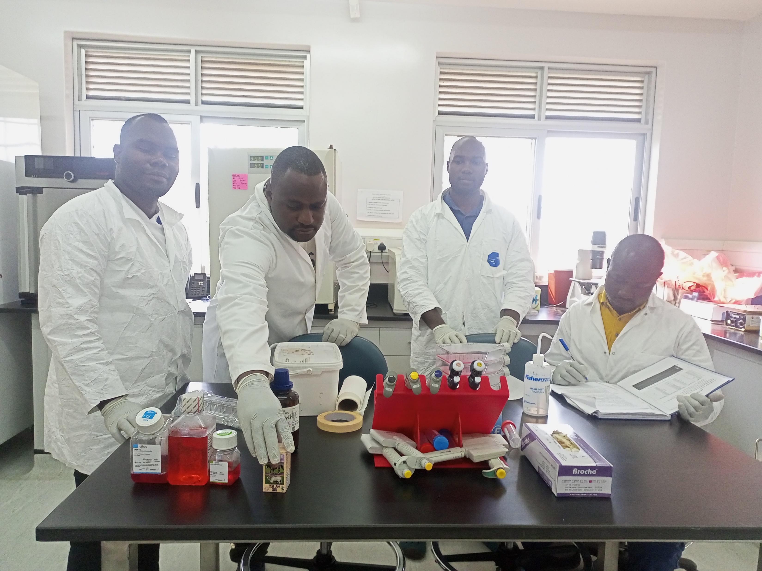
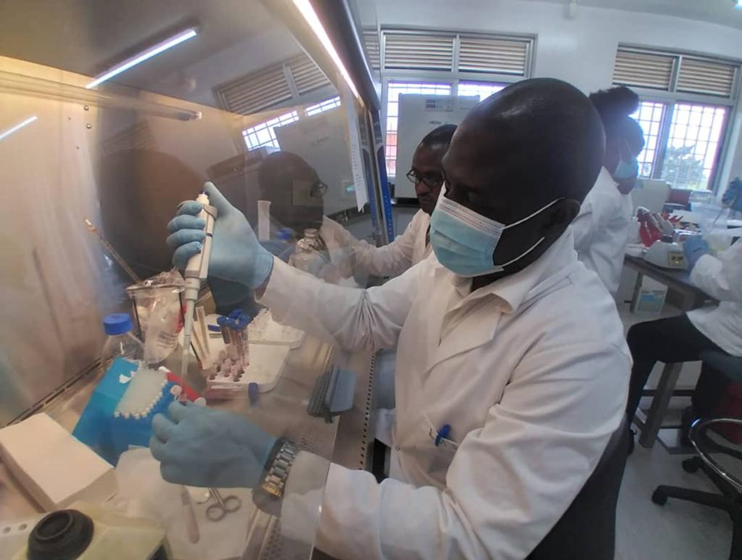
Acknowledgement
Government of Uganda, NARO-NaLIRRI

